Slide 1



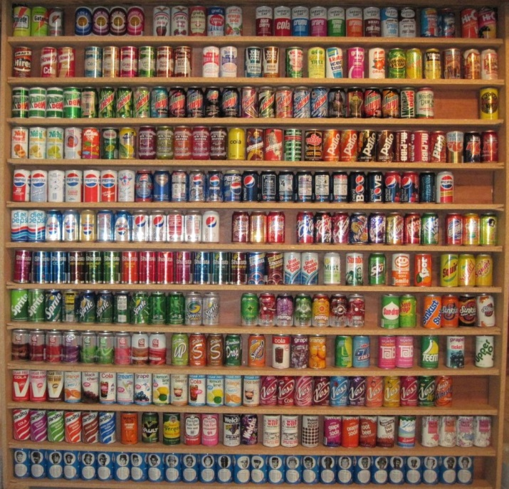
Useful PHP classes and collections
Dates and Intervals, DOMDocument, Manipulating XML, Strings in PHP
Mario Peshev
Technical Trainer
http://peshev.net
Software University
http://softuni.bg

Slide 2

Table of Contents
DateTime Class
DateInterval Class
DOMDocument Class
XMLReader Class
XMLWriter Class
Strings in PHP

Slide 3

DateTime Class

Slide 4
DateTime Class
In-build from PHP 5.2.x ->
Used to manipulate Dates and Times
Can be used to obtain current Date/Time
Functions depend on the locale settings of the server
No need of installation

Slide 5
php.ini configuration
You can configure some settings in php.ini in order to change the behavior of some DateTime functions
Name | Description
date.timezone | The default timezone (used by all date/time functions)
date.default_latitude | The default latitude (used by date_sunrise() and date_sunset())
date.default_longitude | The default longitude (used by date_sunrise() and date_sunset())
date.sunrise_zenith | The default sunrise zenith (used by date_sunrise() and date_sunset())
date.sunset_zenith | The default sunset zenith (used by date_sunrise() and date_sunset())

Slide 6
Using DateTime
Initialized like an object
Can take various constructors
http://php.net/manual/en/datetime.formats.php
$date = new DateTime('2014-07-15');

Slide 7
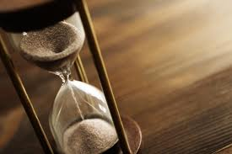
DateInterval Class

Slide 8
DateInterval Class
A date interval stores either a fixed amount of time (in years, months, days, hours etc) or a relative time string in the format that DateTime's constructor supports
The format starts with the letter P, for "period." Each duration period is represented by an integer value followed by a period designator. If the duration contains time elements, that portion of the specification is preceded by the letter T.
//2 Years, 4 Days, 6 Hours and 8 Minutes
$interval = new DateInterval('P2Y4DT6H8M');

Slide 9

DateTime Methods

Slide 10
DateTime Methods
format() – formats the DateTime
add() – adds a period of time to the object
sub() – subtracts a period of time from the object
setdate() – sets a date new value for the object
$date = new DateTime('2014-08-16'); $date->add(new DateInterval('P10D')); //adds 10 days echo $date->format('Y-m-d') . "\n";

Slide 11
DateTime Methods (2)
settime() – sets a new time value for the object
setTimezone () – sets a specific Timezone for the object
$date->setTimezone(new DateTimeZone('Pacific/Chatham'));

Slide 12

Dates and Intervals
Live demo

Slide 13
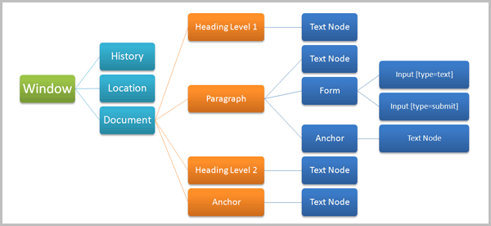
DOMDocument Class

Slide 14
What is DOM?
The Document Object Model (DOM) is a cross-platform and language-independent convention for representing and interacting with objects in HTML, XHTML and XML documents
Objects in the DOM tree may be addressed and manipulated by using methods on the objects
The public interface of a DOM is specified in its application programming interface (API)

Slide 15
DOMDocument
Setting an appropriate content type so the browser recognizes that we want to use xml:
Creating a DOMDocument Object:
header("content-type: application/xml; charset=UTF-8");
$xml = new DOMDocument("1.0", "ISO-8859-15");

Slide 16
DOMDocument (2)
Creating some elements:
Setting some attributes
Creating another element to simulate sublevels:
$xml_album = $xml->createElement("Album"); $xml_track = $xml->createElement("Track", "The ninth symphony");
$xml_track->setAttribute("length", "0:01:15"); $xml_track->setAttribute("bitrate", "64kb/s"); $xml_track->setAttribute("channels", "2");
$xml_note = $xml->createElement("Note", "The last symphony by Beethoven");

Slide 17
DOMDocument (3)
Appending the elements:
Parsing the XML:
$xml_track->appendChild($xml_note); $xml_album->appendChild($xml_track);
$xml->appendChild($xml_album);
print $xml->saveXML();

Slide 18
DOMDocument
Live demo

Slide 19

XMLReader Class

Slide 20
XMLReader
The XMLReader extension is an XML Pull parser.
The reader acts as a cursor going forward on the document stream and stopping at each node on the way
It is important to note that internally, libxml uses the UTF-8 encoding and as such, the encoding of the retrieved contents will always be in UTF-8 encoding
No need of installation

Slide 21
XMLReader (2)
Initializing XMLReader and opening a file:
After that we can read the next Node from the XML and get its attributes:
$reader = new XMLReader();
$reader->open('data.xml');
$xml->read();
echo $xml->name; //gets the node’s name
echo $xml->getAttribute(‘someAttribute'); //gets an attribute
$xml->next(); //gets the next node

Slide 22
XMLReader
Live demo

Slide 23

XMLWriter Class

Slide 24
XMLWriter
Represents a writer that provides a non-cached, forward-only means of generating streams or files containing XML data
This extension can be used in an object oriented style or a procedural one
No need of installation

Slide 25
XMLWriter
Initializing a writer and setting output:
Creating elements and attributes:
Ending and flushing:
$writer = new XMLWriter();
$writer->openURI('php://output');
$writer->startDocument('1.0','UTF-8');
$writer->startElement('color');
$writer->writeAttribute('color', 'A6A6A6');
$writer->endElement();
$writer->endDocument();
$writer->flush();

Slide 26
XMLWriter
Live demo

Slide 27

Strings in PHP

Slide 28
Strings
Single quoted strings - display things almost completely "as is." Variables and most escape sequences will not be interpreted.
The exception is that to display a literal single quote, you can escape it with a back slash \', and to display a back slash, you can escape it with another backslash \\.
Single quoted strings are parsed.

Slide 29
Strings (2)
Double quoted strings - display a host of escaped characters (including some regexes), and variables in the strings will be evaluated
An important point here is that you can use curly braces to isolate the name of the variable you want evaluated
For example let's say you have the variable $type and you what to echo "The $types are" That will look for the variable $types
To get around this use echo "The {$type}s are". You can put the left brace before or after the dollar sign

Slide 30
Strings (3)
Heredoc strings - string syntax works like double quoted strings
It starts with <<<. After this operator, an identifier is provided, then a newline
The string itself follows, and then the same identifier again to close the quotation
You don't need to escape quotes in this syntax

Slide 31
Strings (4)
Nowdoc strings - (since PHP 5.3.0) string syntax works essentially like single quoted strings
The difference is that not even single quotes or backslashes have to be escaped.
A nowdoc is identified with the same <<< sequence used for heredocs, but the identifier which follows is enclosed in single quotes, e.g. <<<'EOT‘
No parsing is done in nowdoc.

Slide 32


Summary
You can use DateTime and DateInterval
classes to manipulate dates and intervals
You can manipulate DOM and XML
There are various types of Strings in PHP
PHP & MySQL

Slide 33
PHP & MySQL
https://softuni.bg/trainings/fasttracks/details/1033

Slide 34
License
This course (slides, examples, demos, videos, homework, etc.) is licensed under the "Creative Commons Attribution-NonCommercial-ShareAlike 4.0 International" license
Attribution: this work may contain portions from:

Slide 35





Free Trainings @ Software University
Software University Foundation – softuni.org
Software University – High-Quality Education, Profession and Job for Software Developers
softuni.bg
Software University @ Facebook
facebook.com/SoftwareUniversity
Software University @ YouTube
youtube.com/SoftwareUniversity
Software University Forums – forum.softuni.bg

